Slide 1
CNC Design and Analysis

Slide 2
Content
Chapter 6: Design and Analysis of CNC
Mechanical System
Feedback Sensors
Electrical System
Velocity Control Loop
Position Control Loop
Following Error
State Space Model
Sliding Mode Controller
Active Damping
Virtual CNC
Friction Modelling
Active Damping using Input Shaping
Active Damping
Contour Error Compensation

Slide 3
Mechanical Systems

Slide 4
Mechanical Components
Feedrives: Ballscrew, Motors, Table and Workpiece
Spindledrive: Spindle unit, Rotary motor

Slide 5
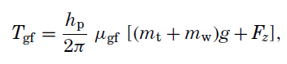
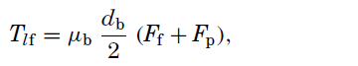
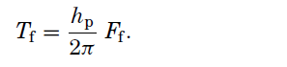
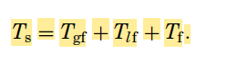
Feedrive System
Friction in guideways
Friction due to preload
Cutting Force
Static Torque Reduction

Slide 6
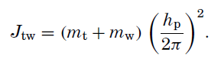
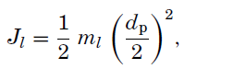
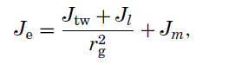
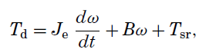
Feedrive System
MoI of Table and Workpiece
MoI of Leadscrew
Dynamic Torque Reduction
Total Torque Reduction

Slide 7
Feedback Sensors
Tachometers: Used to detect the velocity of the servo drive
Encoders: Used to detect the position in the servodrives

Slide 8
Electrical Drives

Slide 9
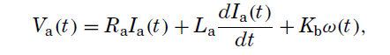
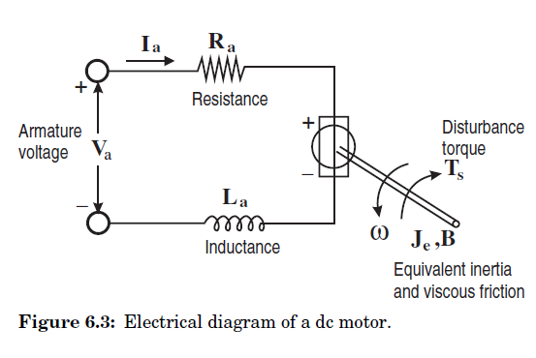
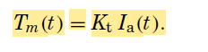
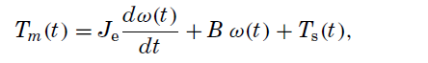
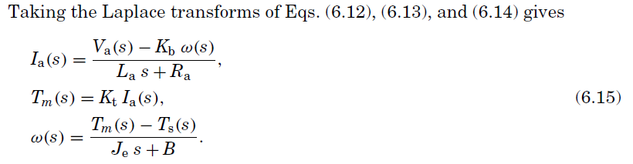
DC Motor Drive

Slide 10
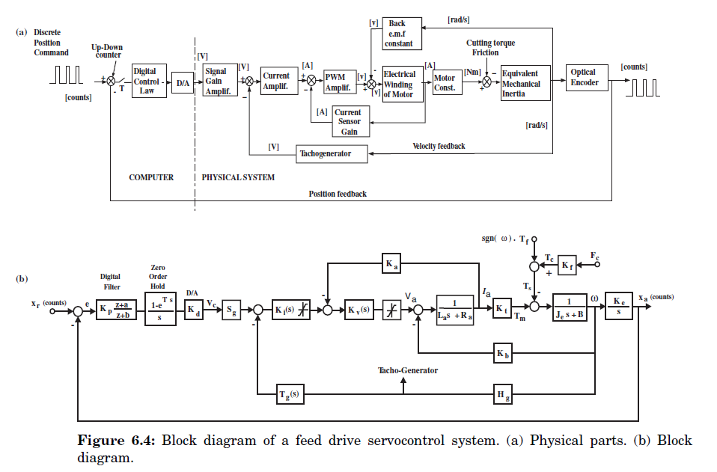
Velocity Control Loop

Slide 11
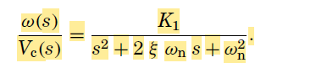
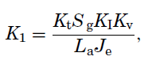
Velocity Transfer Function
Wn - Natural Freq
Epsilon - Damping Ratio

Slide 12
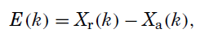
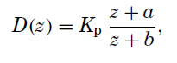
Position Control Loop
Components:
i. Up Down Counter: Measures the Position Error
ii. Digital Compensation Filter: Modifies the error value using mathematical equation
iii. DAC: Receives the digital value from Filter to convert into analog Velocity command signal

Slide 13
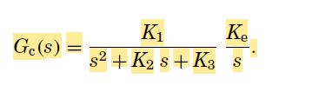
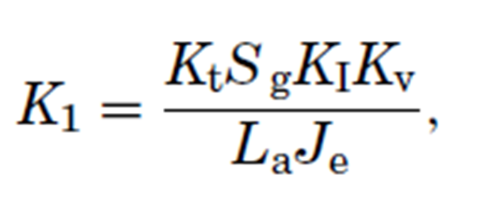
Position Transfer Function

Slide 14
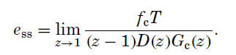
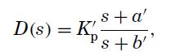
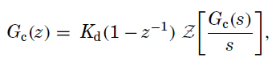
Following Error
It is the difference between the desired position and actual position of spindle at steady state i.e. the steady State Position Error
fc -> Feeding Velocity

Slide 15
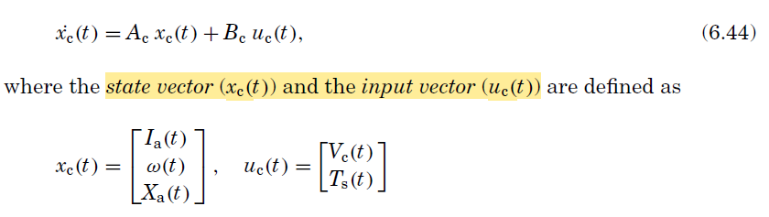
State Space Model
Converting the nth order differential equations into n 1st order differential equations to analyze the output parameters
Defined by 3 States:
i. Armature Current
ii. Angular Velocity
iii. Position of the device

Slide 16
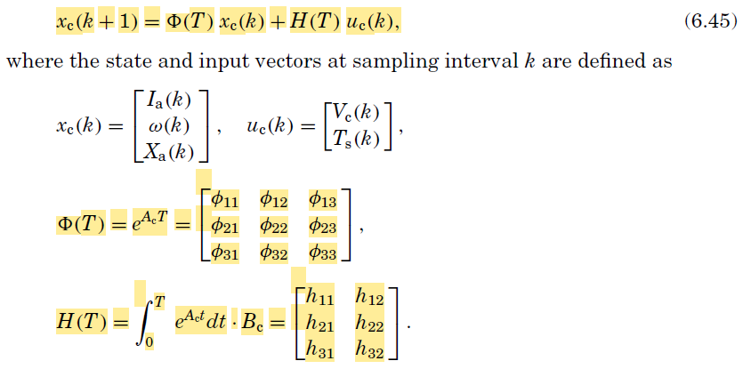
6.44 was the continuous domain representation, its discrete equivalent is

Slide 17
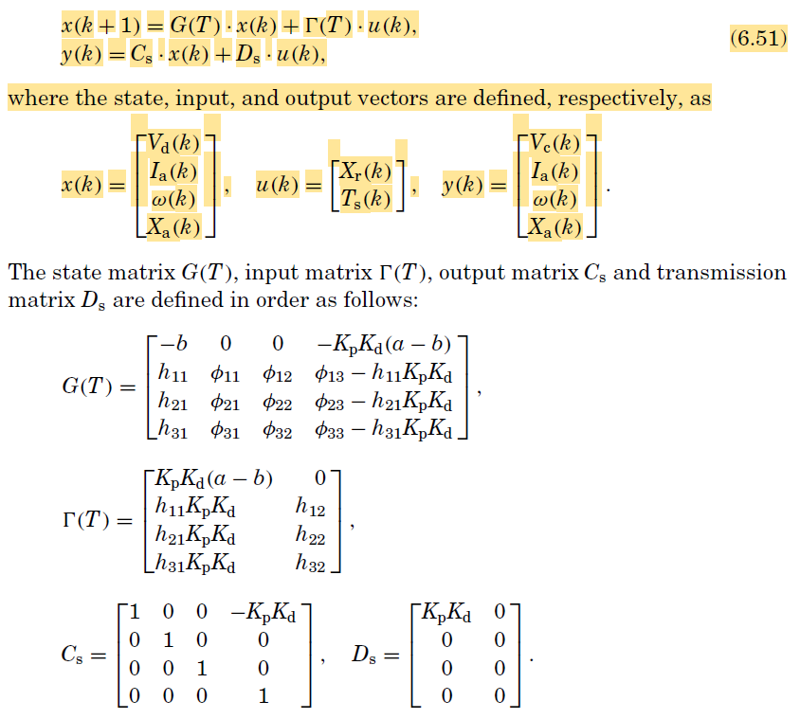
The algebraic rearrangements, we can obtain the output vector based on the given input and state vectors

Slide 18
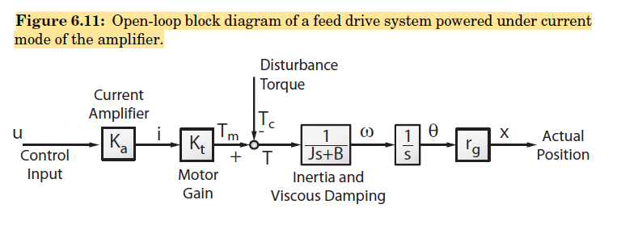
Sliding Mode Controller
It is a roboust, non linear control system that helps us minimize the error in our system even when the external forces are not modelled accurately

Slide 19
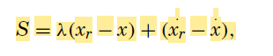
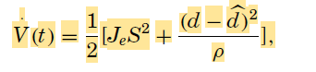
Designing a sliding mode controller:
i. Appropriate slide surface
ii. Lyapunov Function
d -> disturbance
rho -> parameter adaption gain

Slide 20
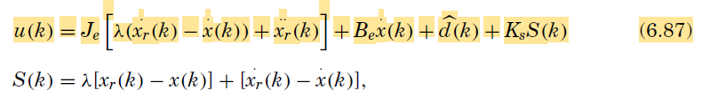
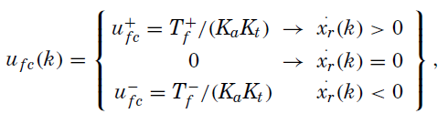
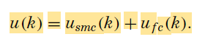
Modification in control input (u)
Feedforward Friction
Compensation

Slide 21
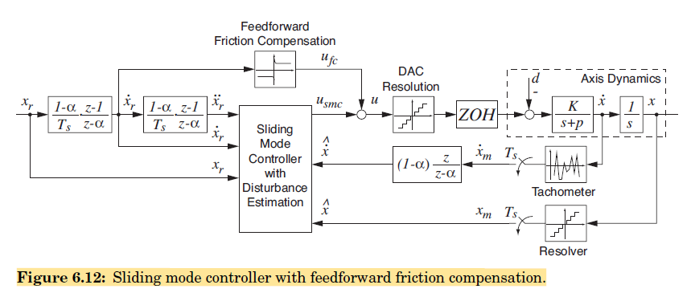
Block Diagram of the Sliding Mode Controller

Slide 22
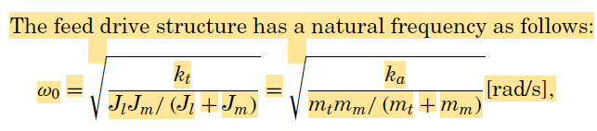
Active Damping
The leadscrew may experience torsional flexibility, leading to contact with the guideway during its movement
This would lead to vibration during operation of the machine

Slide 23
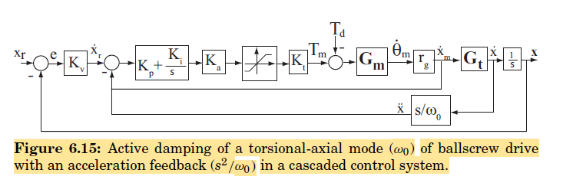
Block Diagram of the Cascaded Control Architecture

Slide 24
Virtual CNC Examples

Slide 25
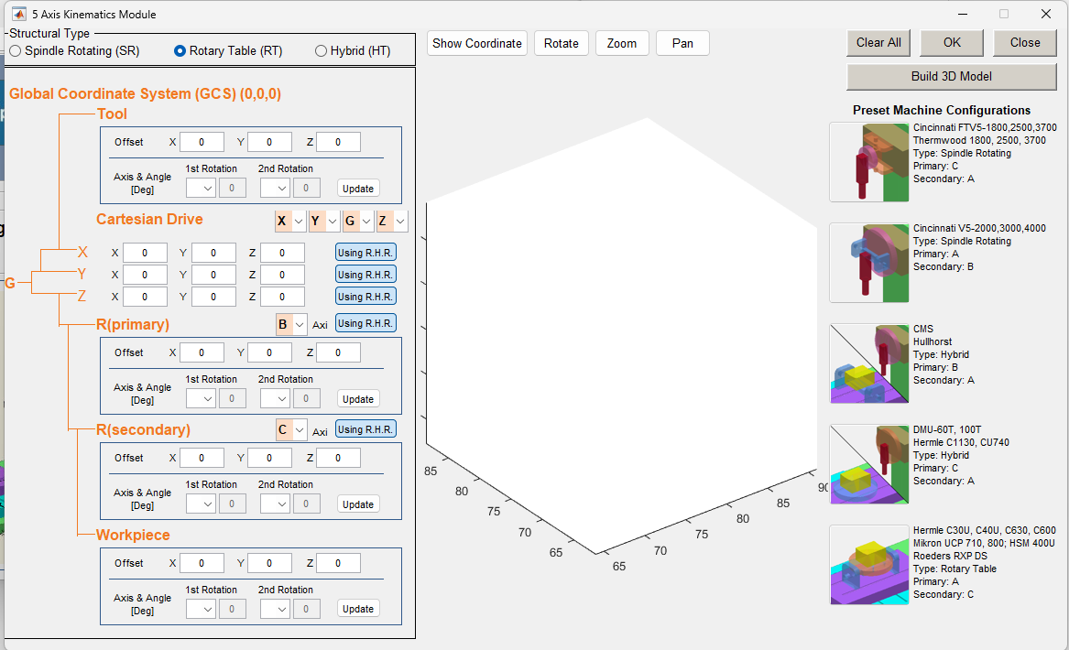
Example: Friction Modelling

Slide 26
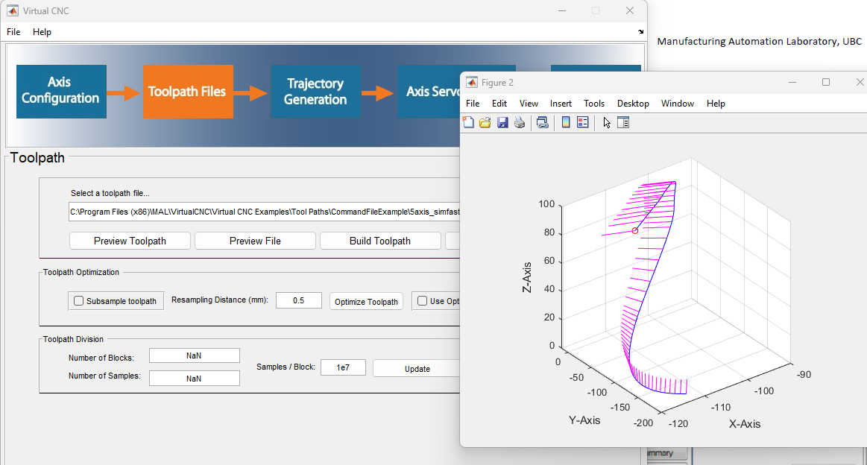

Slide 27
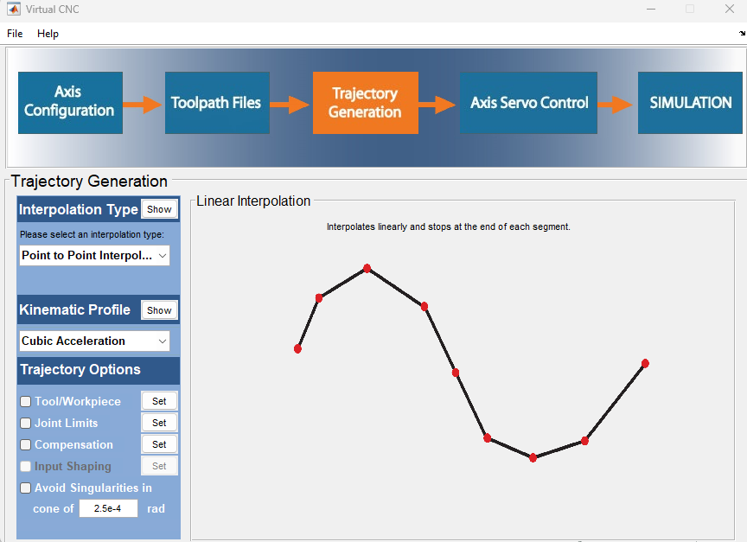
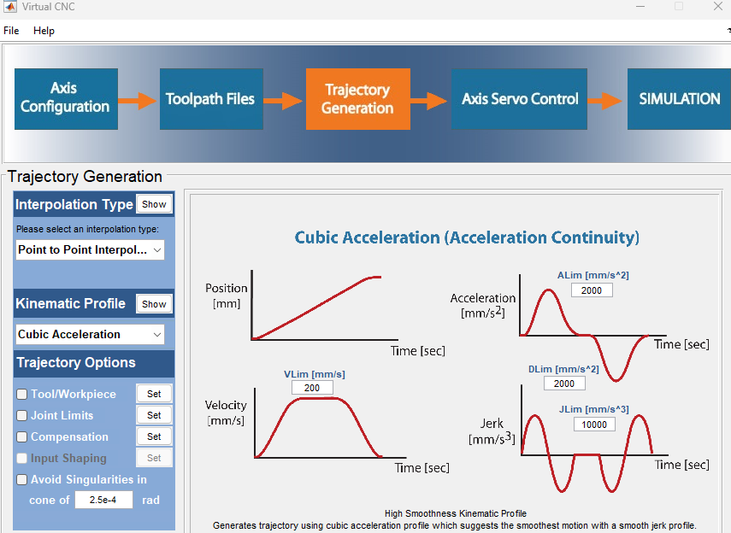

Slide 28
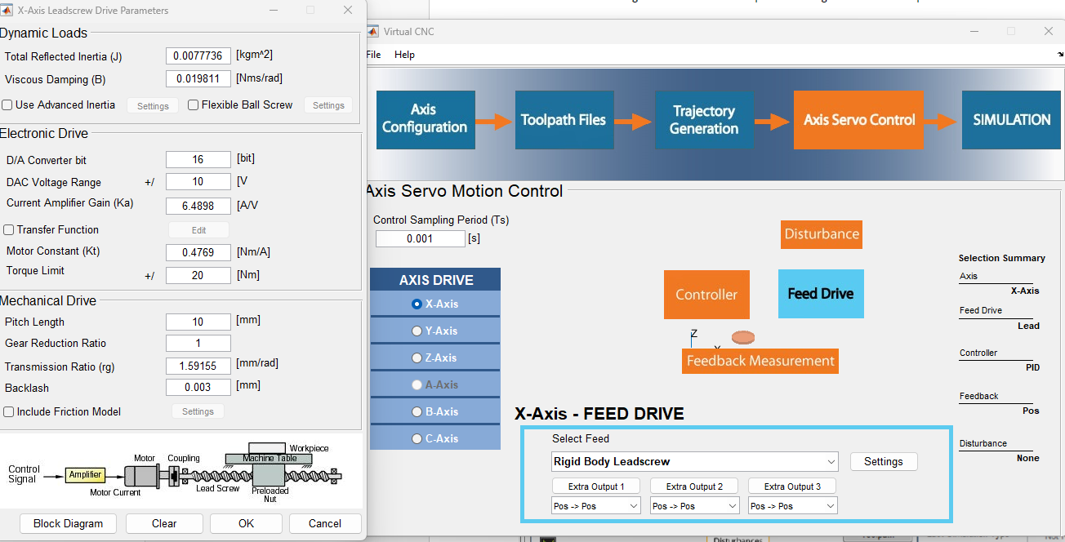

Slide 29
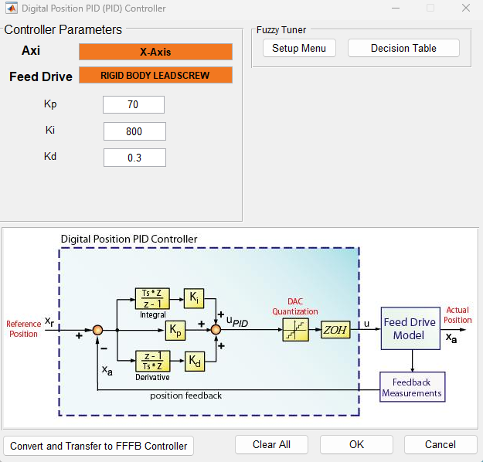
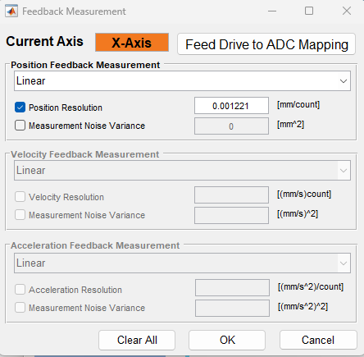

Slide 30
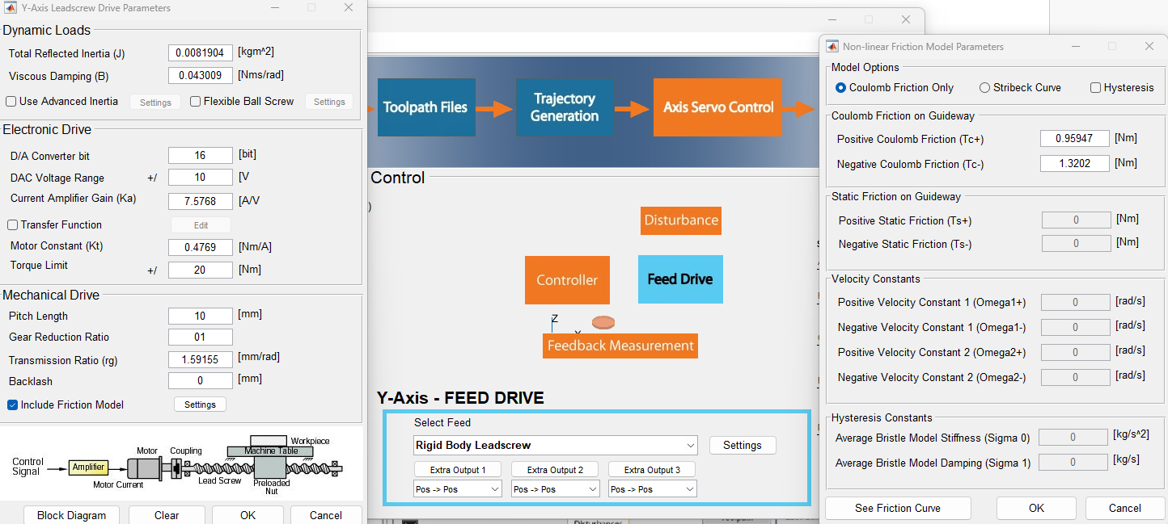
The controller and feedback for Y and Z axis is same as X axis

Slide 31
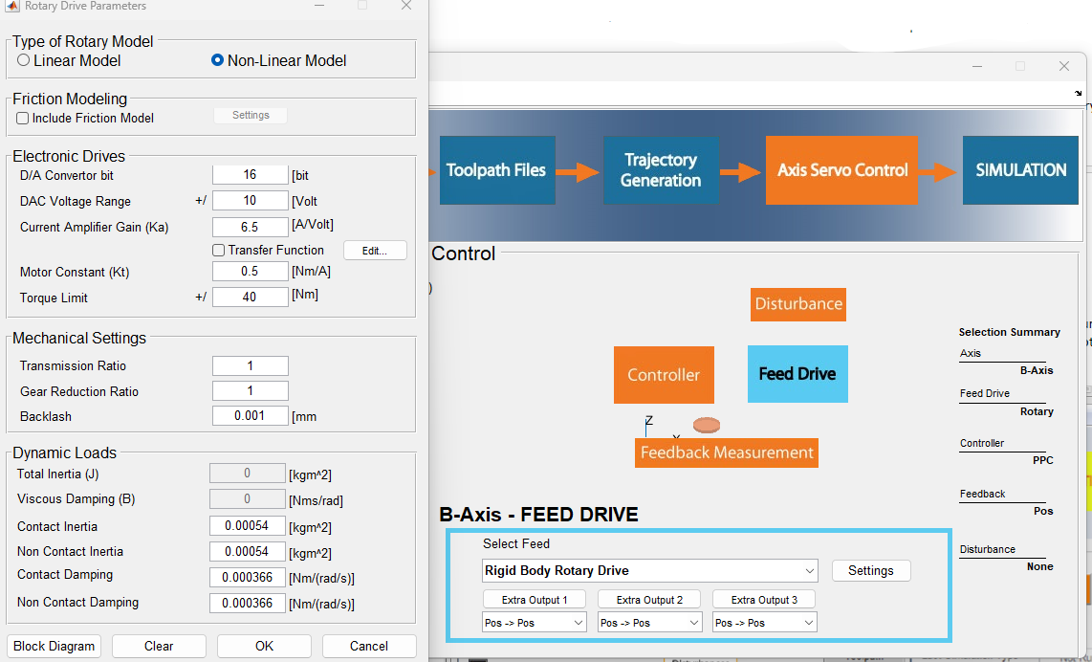

Slide 32
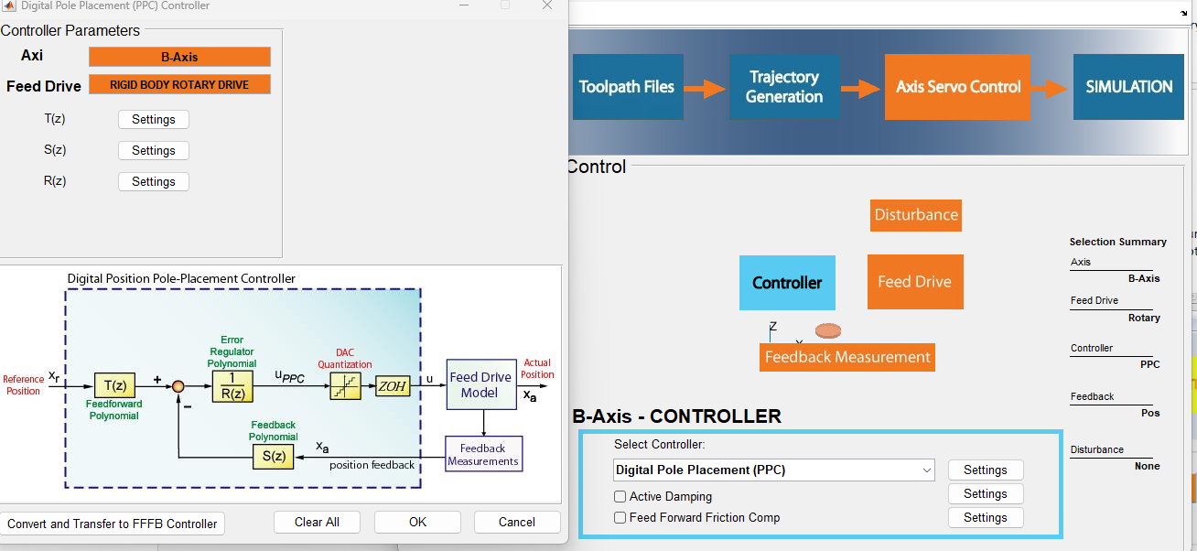
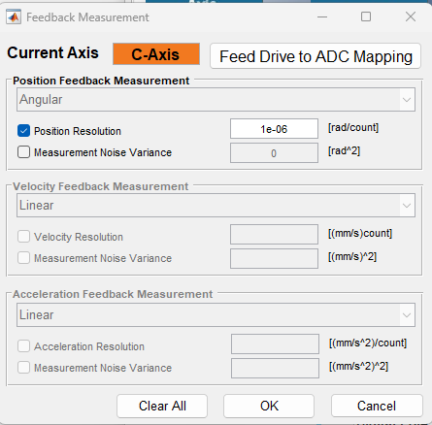

Slide 33
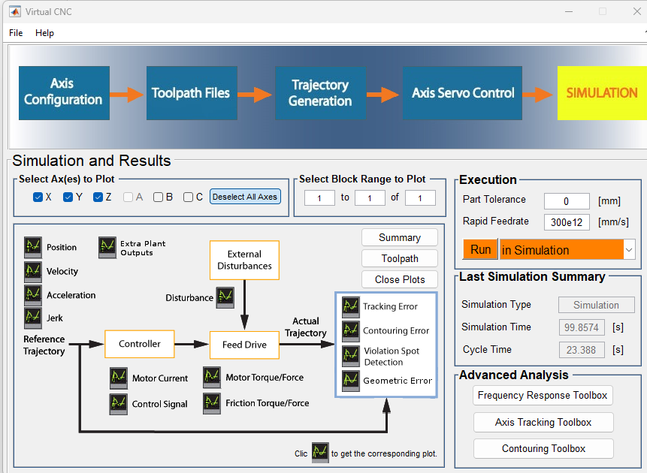

Slide 34
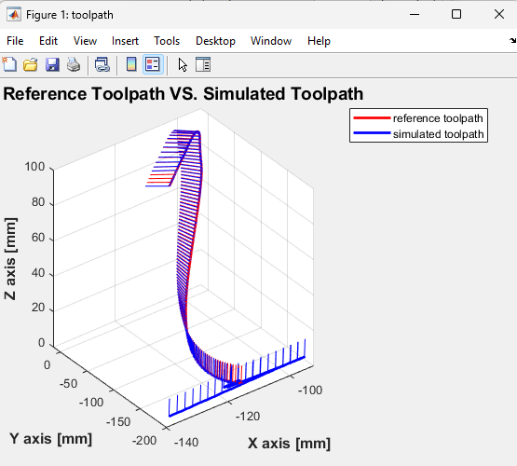

Slide 35
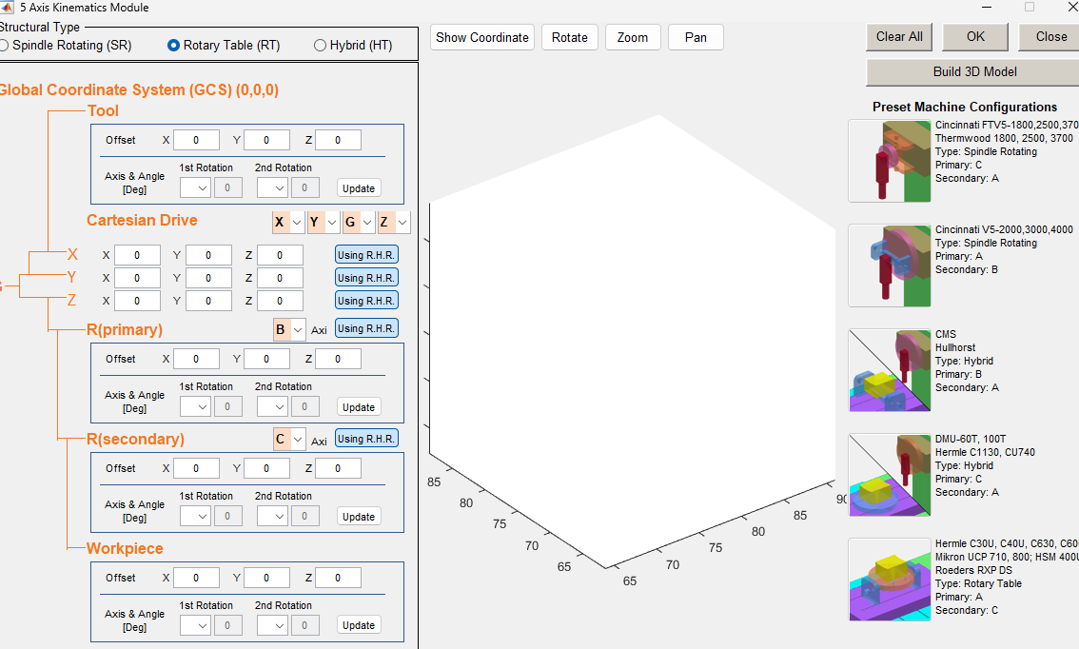
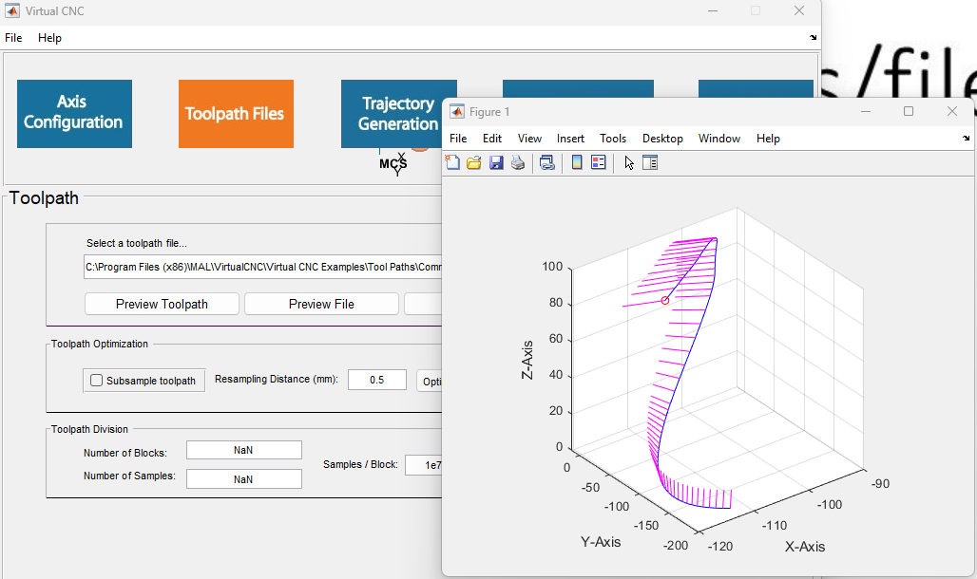
Example: Contour Compensation

Slide 36



Slide 37

We keep the Same Configuration for X and Y Axis

Slide 38


Slide 39



Slide 40


Slide 41


Slide 42



Slide 43



Slide 44

Active Damping Using Input Shaping

Slide 45


Slide 46



Slide 47


Slide 48



Slide 49


Slide 50


Slide 51




Slide 52



Slide 53

Active Damping

Slide 54


Slide 55


Slide 56


Slide 57



Slide 58
Y Axis:
Feed Drive set exactly as X axis
Controller set as X axis without active damping
Feedback set as X axis
Z Axis:
Feed Drive set exactly as X axis
Controller set exactly as Y axis
Feedback set exactly as X axis

Slide 59


Slide 60
Thank you!

